Slide 1
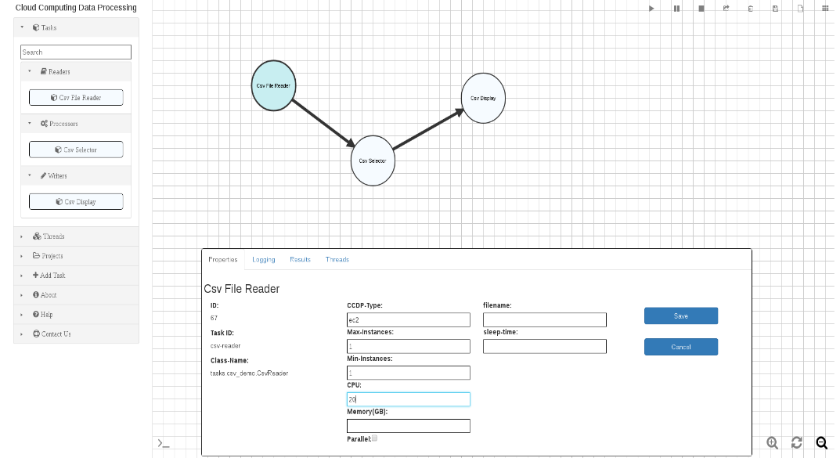
EIS 2018 IRaD – CCDP (Cloud Computing Data Processing)
Continue with framework testing and bug fixing
Develop GUI to allow users to manage and control modules and running threads
Develop configuration page for system administration
Incorporate the use of Lambda functions
Continue the NiFi Integration
Incorporate Elastic Search and Kibana to the framework for data analysis.
Framework
Implement framework to be cloud agnostic
Use AWS as testing platform due to current government implementations of IC-ITE such as C2S and GovCloud
Facilitates dynamic resource allocation
Incorporate other processing frameworks such as NiFi
Visualization
Provide metrics of system’s performance for status
Graphical User Interface
Facilitate the interaction between system and users by providing different user interfaces
Budget: $50k
Spending through 10 Feb 2018: $8k
Accomplishments through 9 Feb 2018:
New developer getting up to speed of how the system works and the direction is going
Elastic Search and Kibana installed and accessible
First Quarter Planned Milestones:
Train new developer
Integrate Elastic Search and Kibana
Programs/Pursuits supported by IRAD:
Seven Hills
Project Contact: Oscar Ganteaume, oganteaume@lgsinnovations.com, (703) 665-7259

